Slide 1


Slide 2
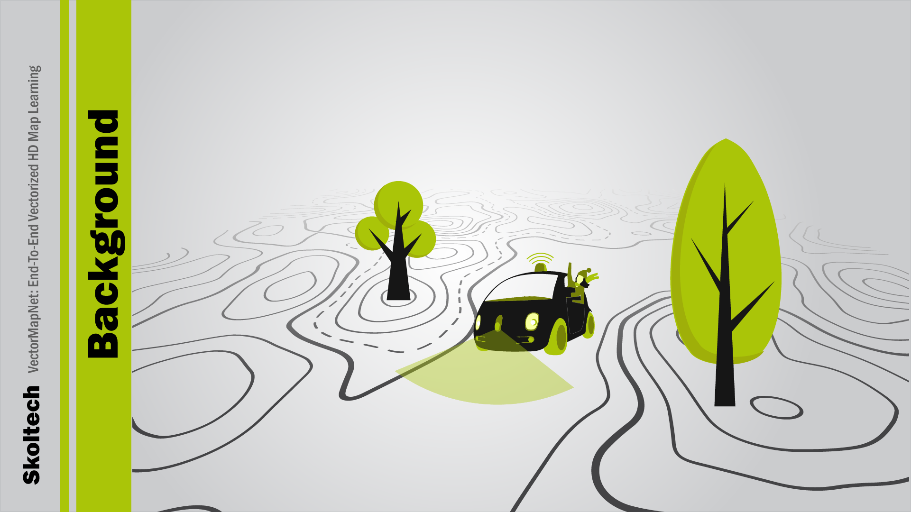
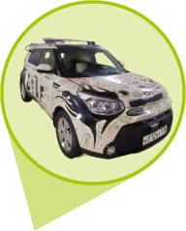
2/8

Slide 3
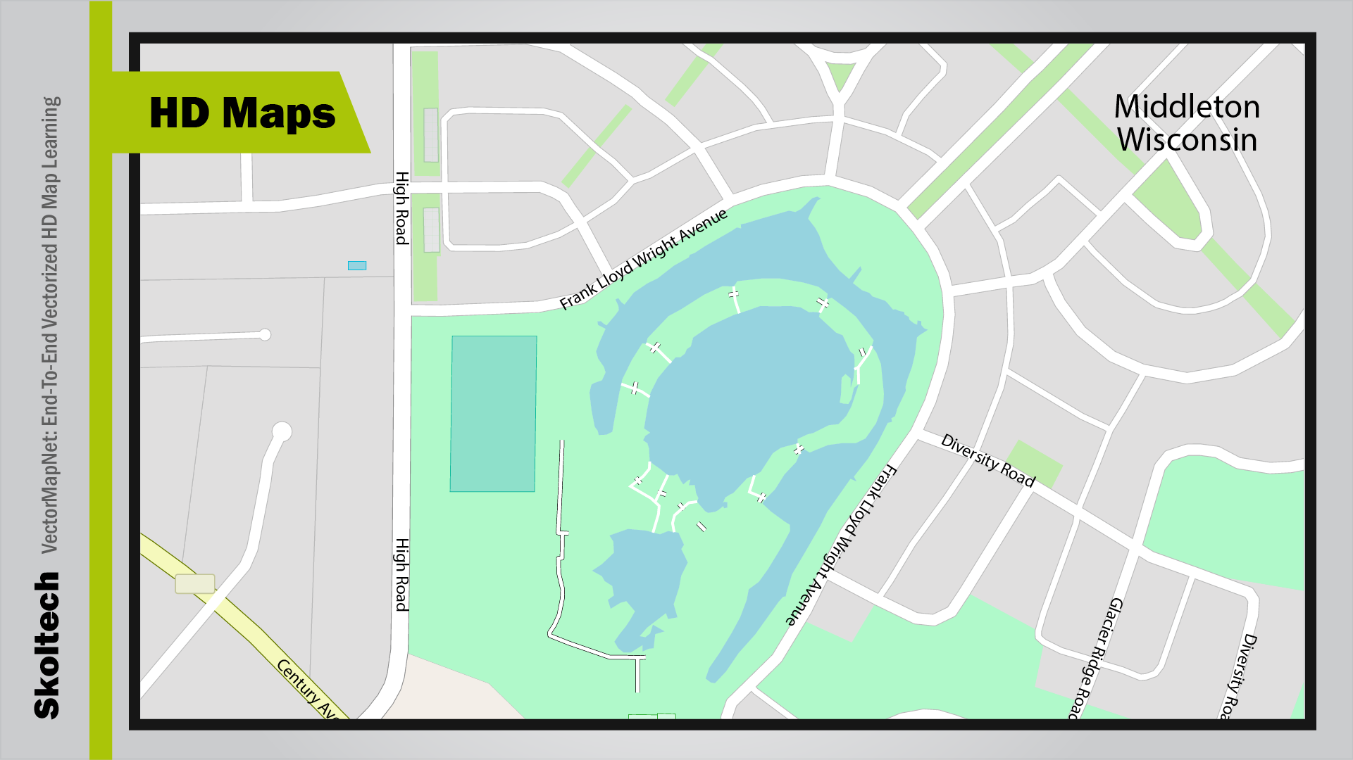
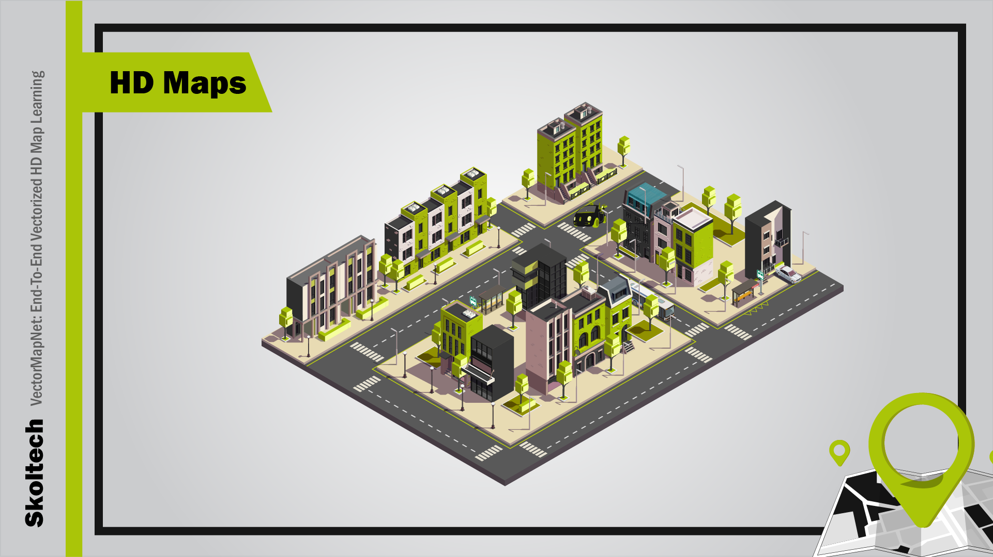
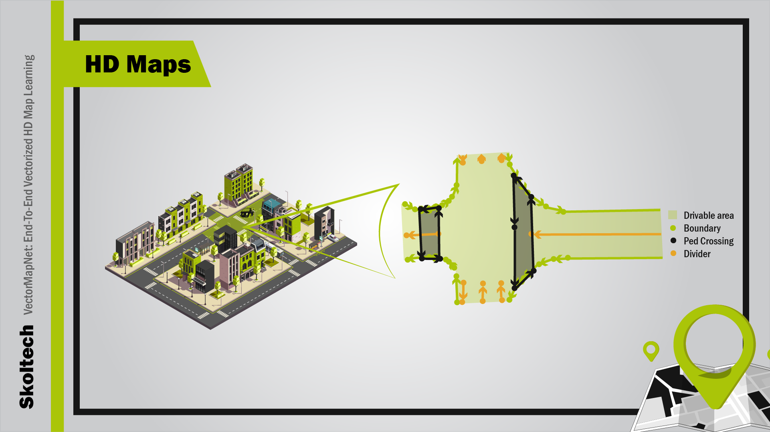

3/8

Slide 4
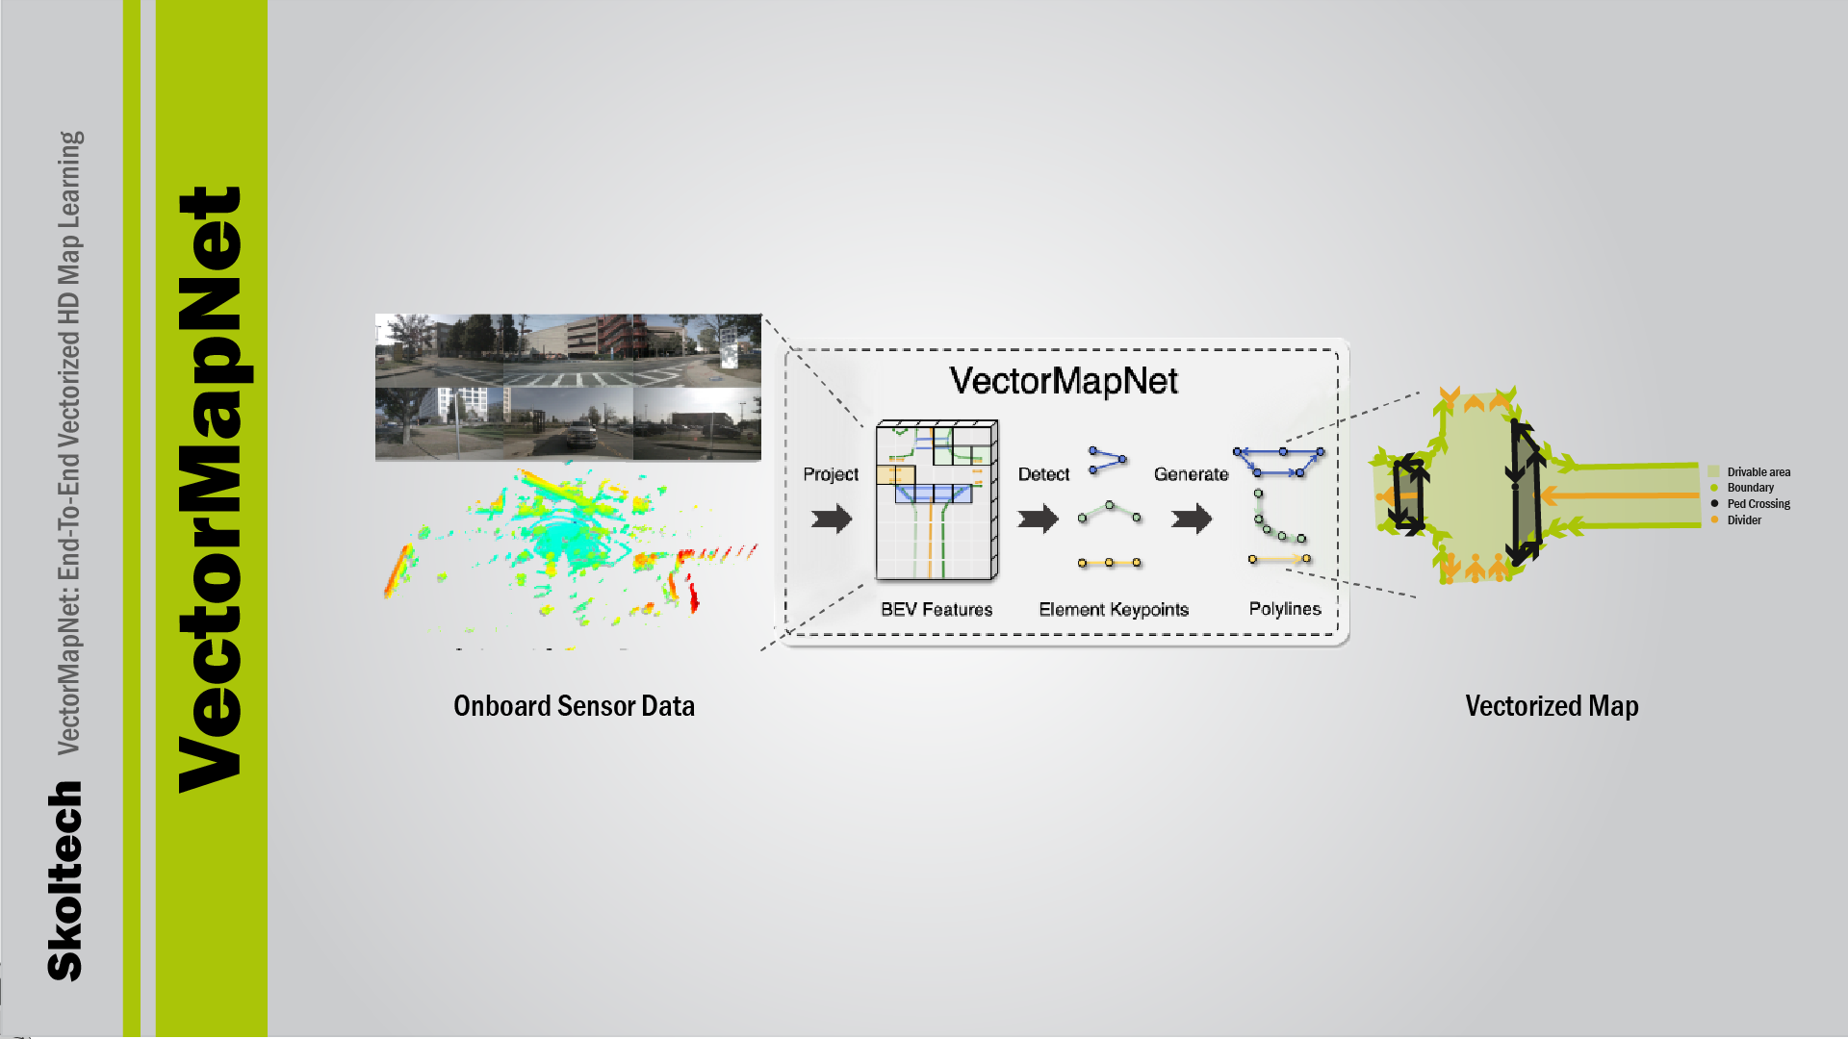
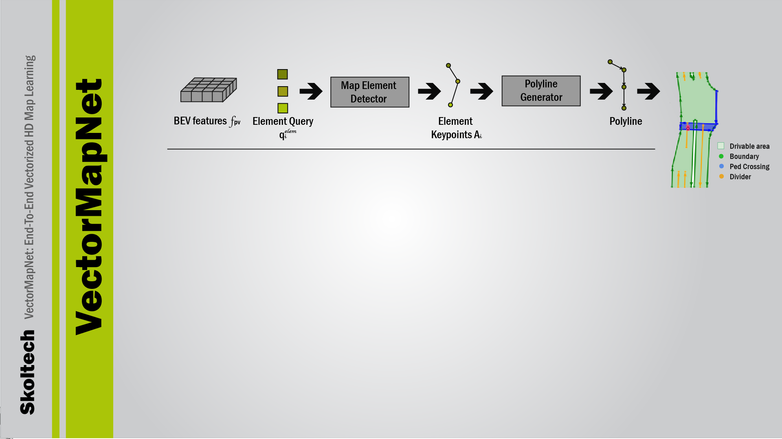
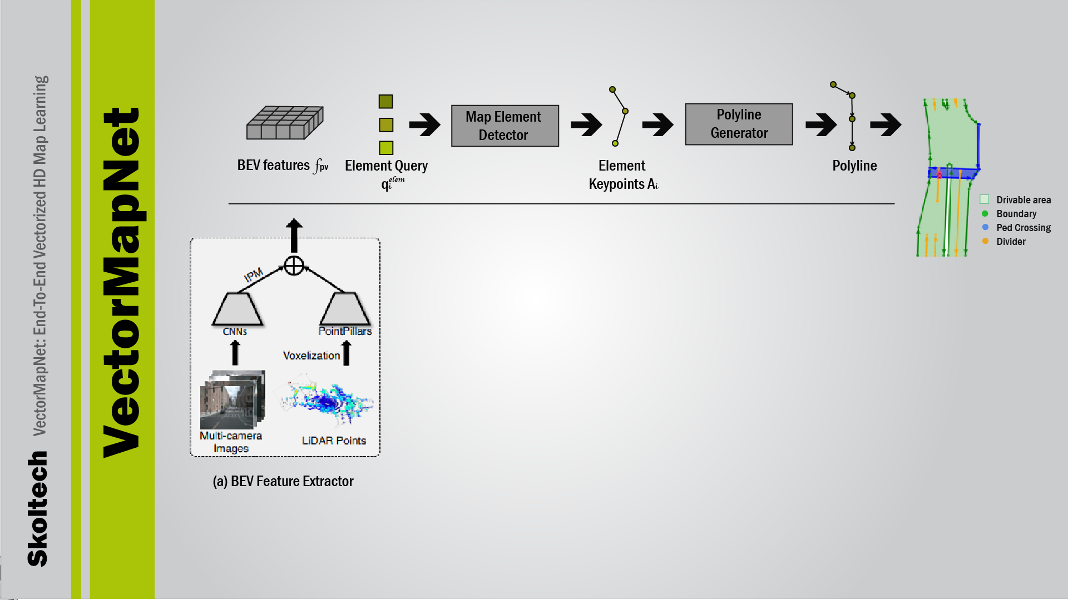
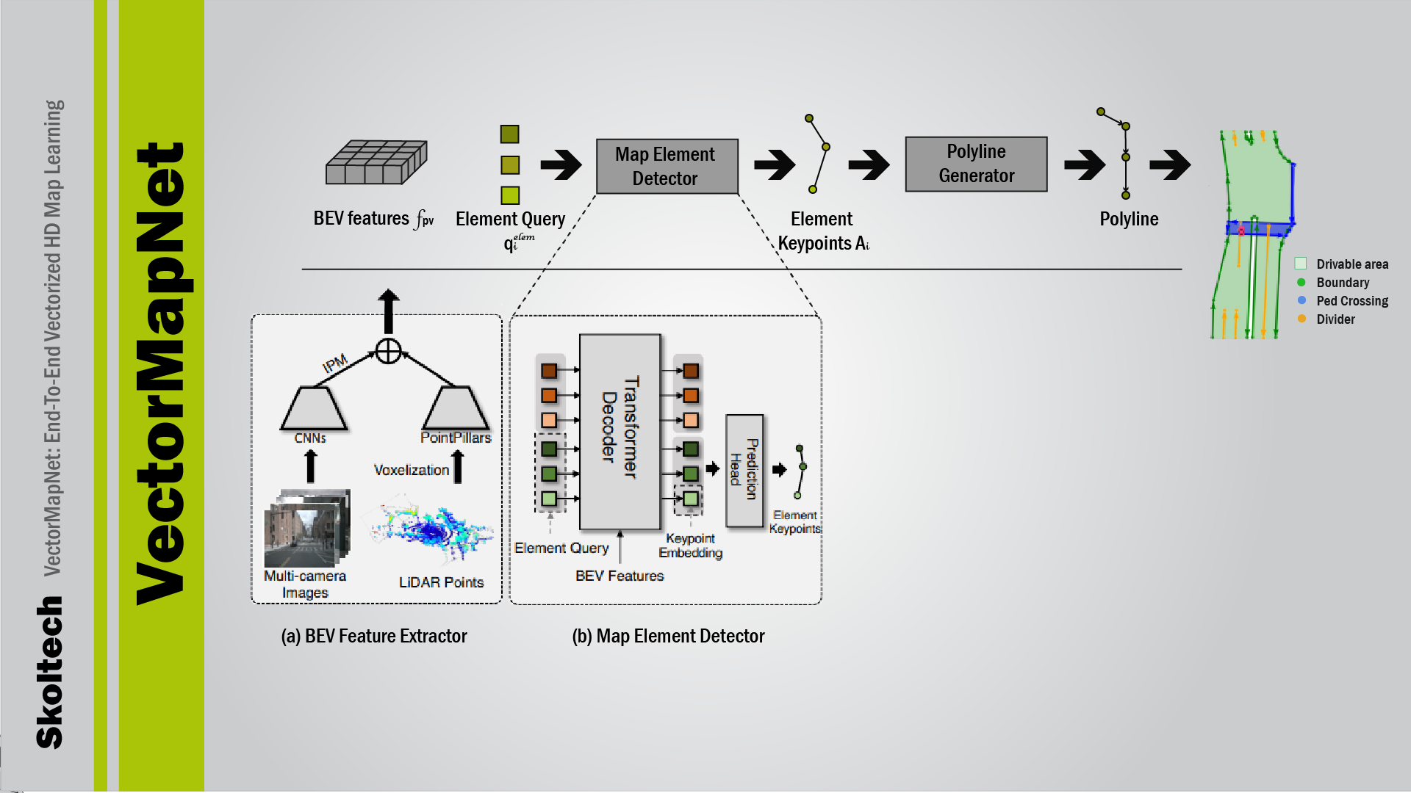
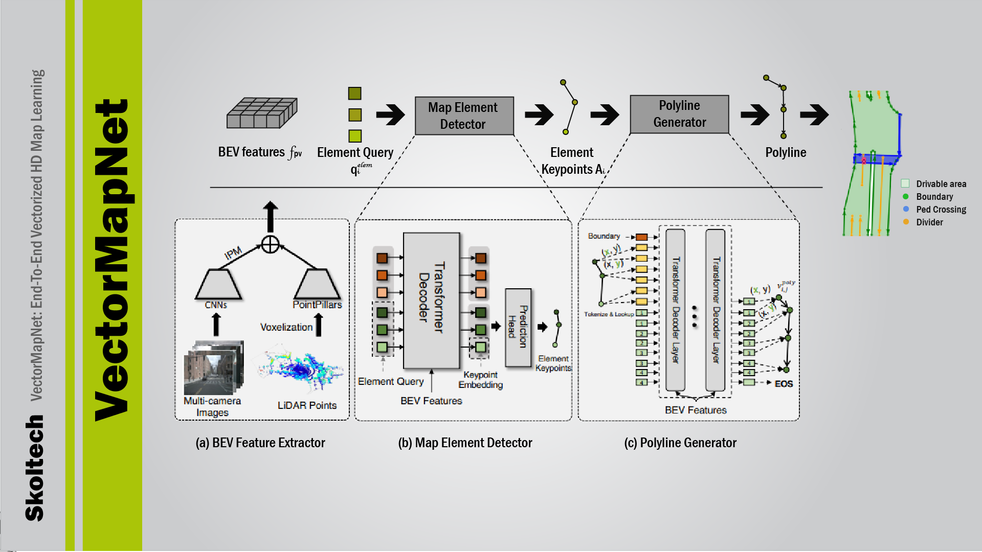
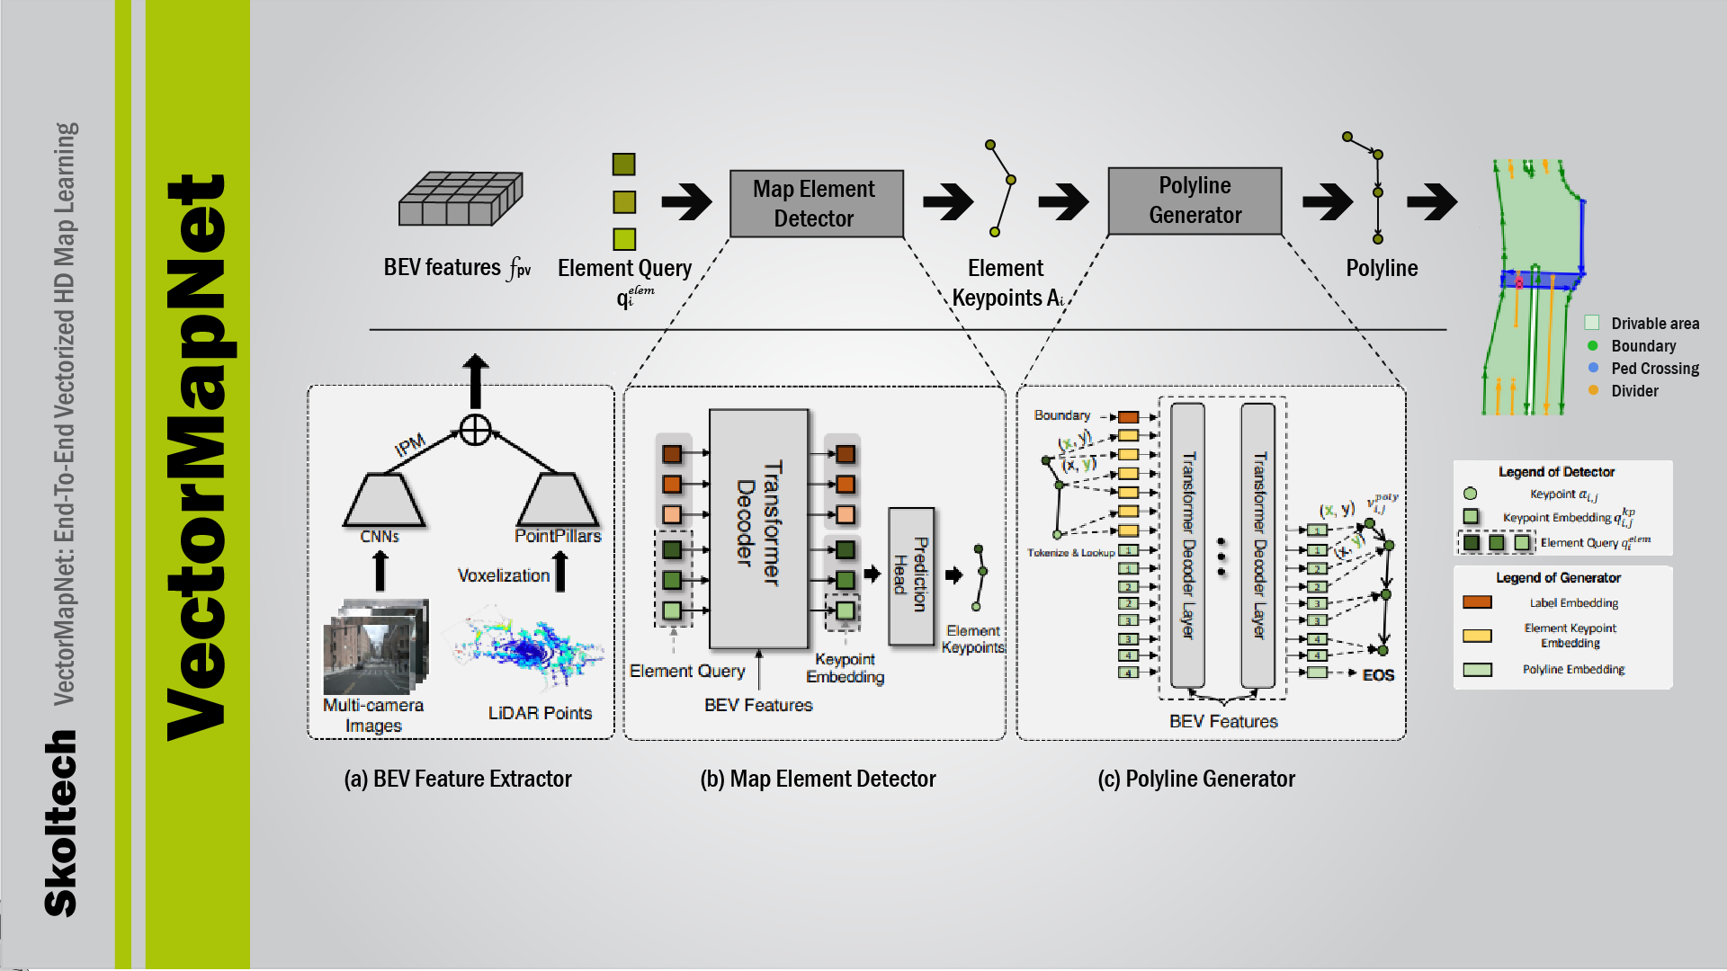
4/8

Slide 5
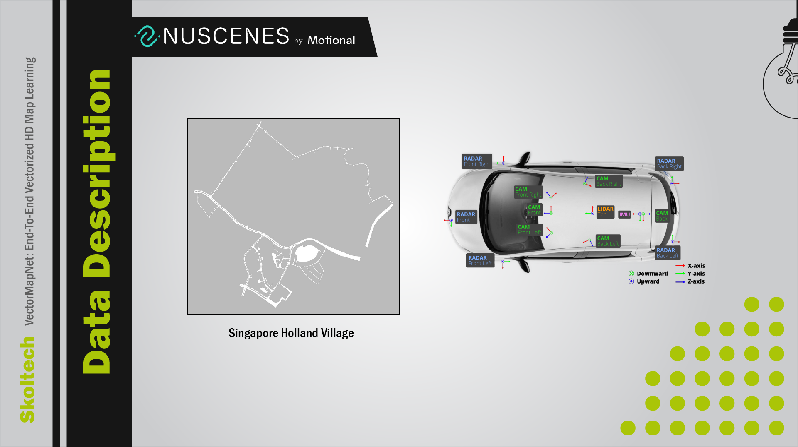
5/8

Slide 6

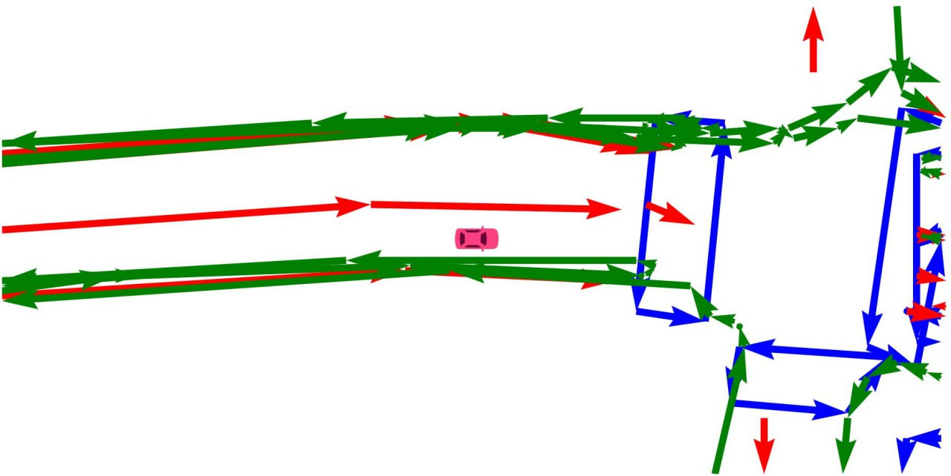
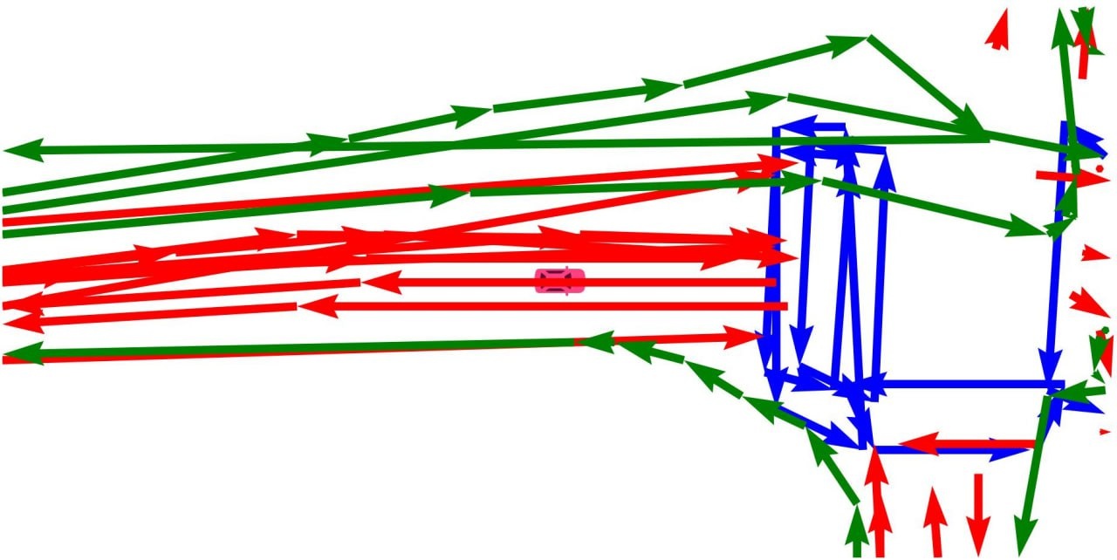
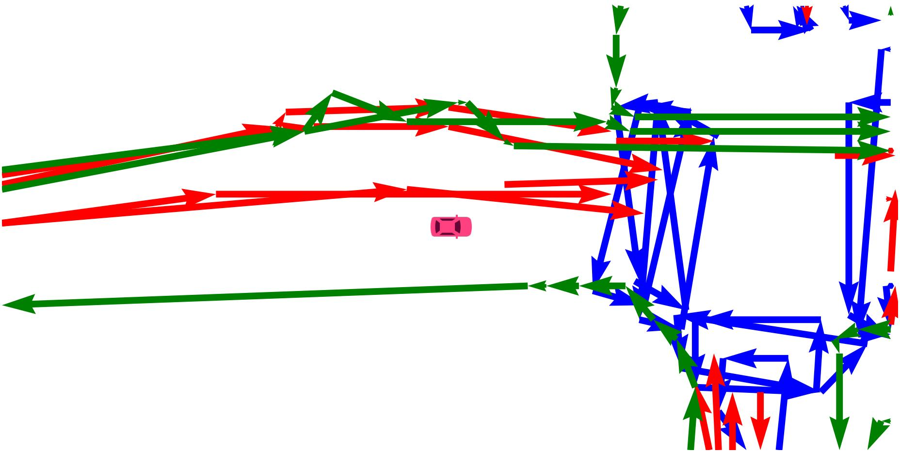
Class | Recall | Avg. Precision
Pedestrian crossing | 0.974 | 0.956
Divider | 0.939 | 0.890
Contours | 0.809 | 0.699
 | mAP | 0.848
Class | Recall | Avg. Precision
Pedestrian crossing | 0.961 | 0.679
Divider | 0.717 | 0.458
Contours | 0.496 | 0.226
 | mAP | 0.454
Table 1. Evaluation results for author weights.
130 epochs
Table 2. Evaluation results for weights trained
From scratch
36 epochs
Author result map
Our trained model produced map
(18 epochs)
Our trained model produced map
(36 epochs)
6/8

Slide 7
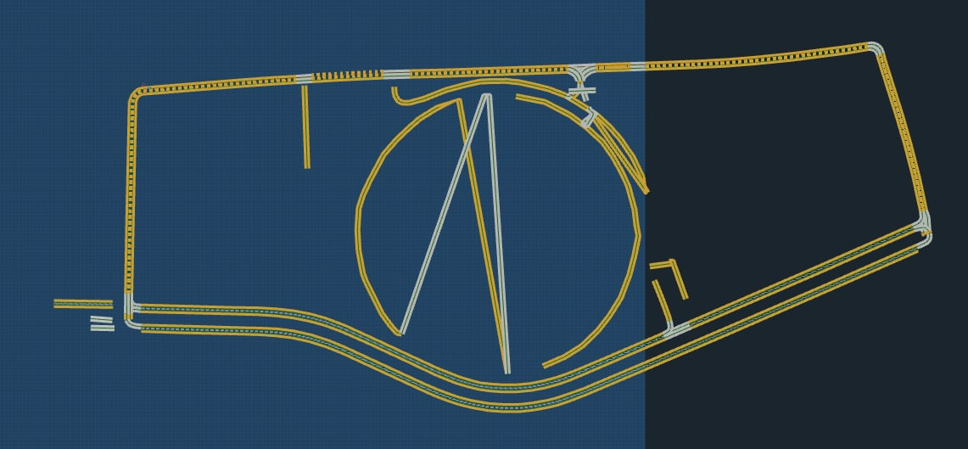
Skoltech HD Map (Manual processing)
7/8

Slide 8
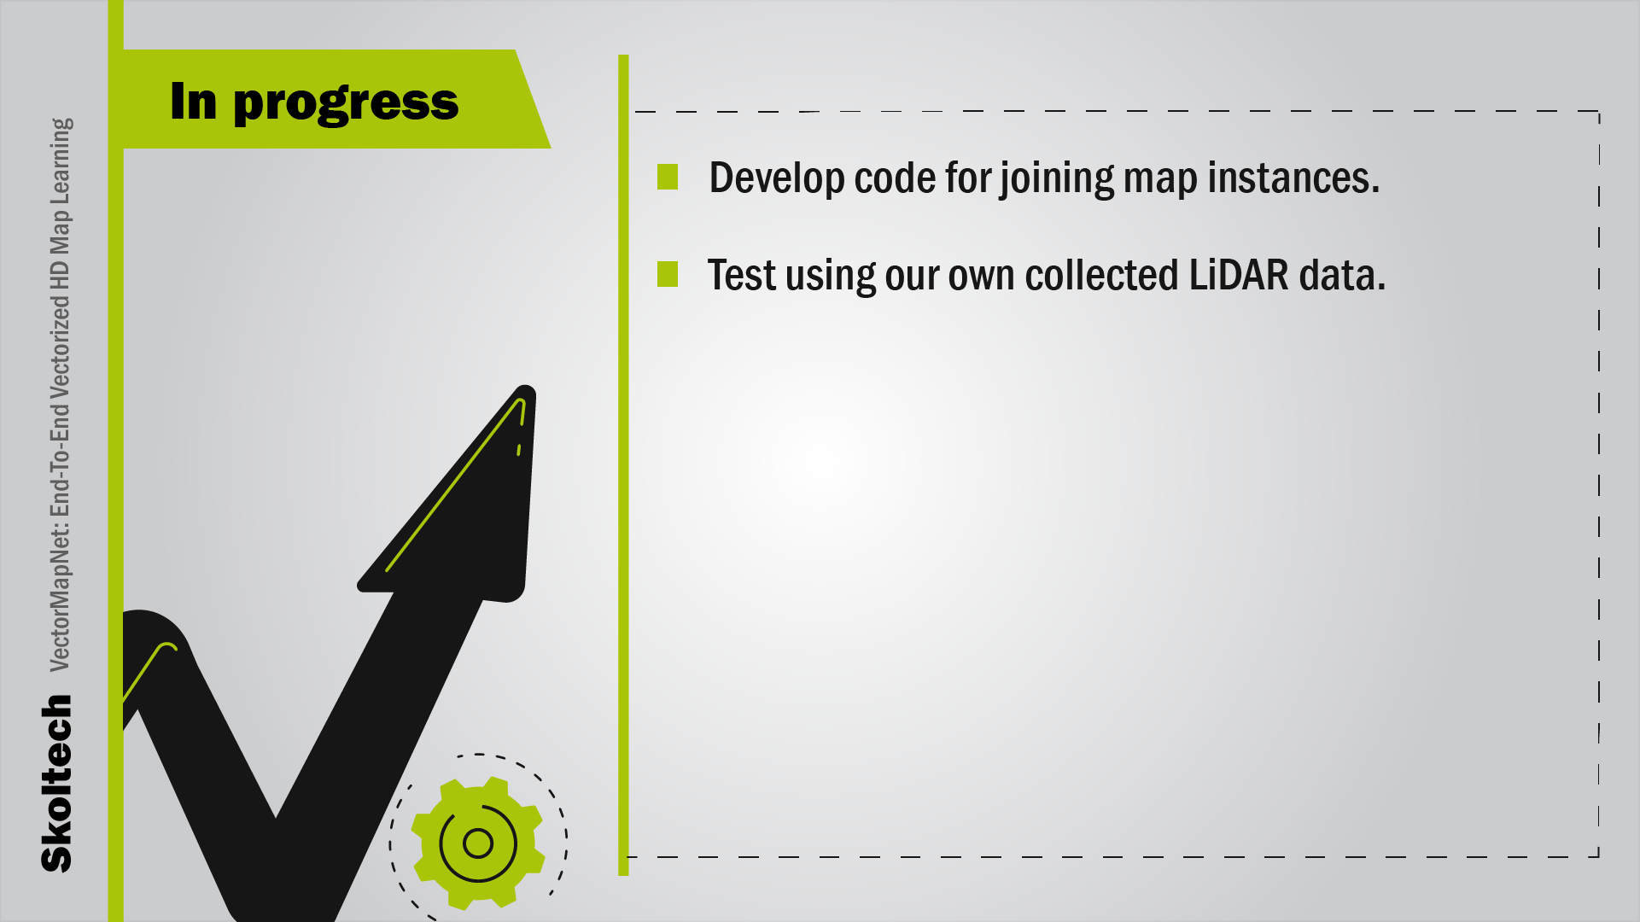
8/8

